Slide 1

Seminar on
“WORKING AND INTERFACING OF DHT11 TEMPERATURE SENSOR”
by
Abdul Rehman
26109023009
First Semester MTech.
Embedded Control and Automation
school Of Electrical Engineering

Slide 2
Contents:
Introduction
DHT11 Working
DHT11 Data Format
Communication Process
Interfacing DHT11 With STM32
Interfacing DHT11 With LPC1768

Slide 3
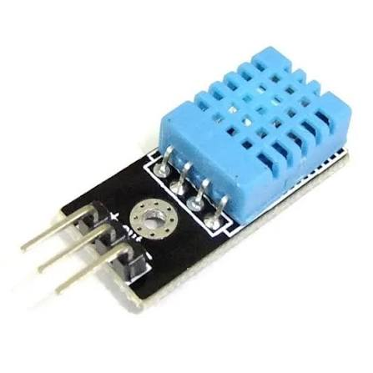
INTRODUCTION:
The DHT11 is a low-cost digital humidity and temperature sensor that is used to measure the environmental conditions around it. It combines a resistive humidity sensing element, a negative temperature coefficient (NTC) thermistor for measuring temperature, and an 8-bit microcontroller which calculates the values and gives calibrated digital output. The DHT11 uses a single wire digital interface to communicate with the microcontroller. It is appropriate for use in embedded systems and environmental monitoring systems such as weather stations. It is cheap and easy to interface, hence useful in projects involving temperature and humidity measurements [1].

Slide 4
DHT11 FEATURES:
DHT11 is a low-cost, small-sized & easy-to-operate embedded sensor, consisting of 4 pins, used to measure Temperature(0°C to 50°C with ±2°C accuracy ) & Relative Humidity (20% to 80% with ±5% accuracy ) and provides calibrated digital output.[2]
DHT11 has a Capacitive Sensor for measuring humidity & NTC Thermistor for temperature sensing. [2]
DHT11 updates the output value once every 2 seconds[2]
Small-size, low-cost, precise & calibrated output and up to 20 meters signal transmission stand it out from other sensors. [2]
DHT11 uses a single-wire serial interface for data processing. [2]
It has a sampling frequency of 1Hz, so it samples the data after every 1sec. [2]
DHT11 has a dimension of 27mm x 59mm x 13.5mm (1.05" x 2.32" x 0.53"). [2]
It is quite accurate & precise in its readings as compared to other expensive sensors i.e. SHT10, DS18B20 etc. [2]

Slide 5
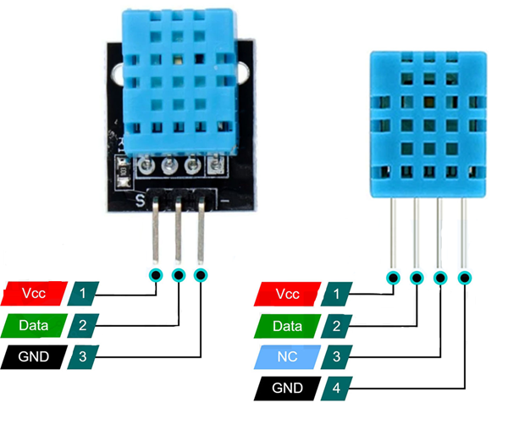
DHT11 PIN OUT:
Pin | Type | Parameters
Pin 1 | VCC | Provide 3.3V to 5V at this pin.
Pin 2 | Data | This pin provides a digital output.
Pin 3 | NC | Not Connected.
Pin 4 | GND | This pin is used for Ground

Slide 6
DHT11 TYPES:
Feature | DHT11 Sensor (Raw 4-Pin) | DHT11 Module (3-Pin)
Number of Pins | 4 pins | 3 pins
Pull-up Resistor | Not included (must add manually) | Built-in resistor
Ease of Wiring | Requires more wiring | Very easy to connect
Size | Smaller, raw component | Slightly larger due to PCB
Consumer Level | Better for experienced | Beginner-friendly
Connection Pins | VCC, Data, NC, GND | VCC, Data, GND
Risk of Error | Higher (manual resistor needed) | Lower (plug-and-play)

Slide 7
TECHNICAL SPECIFICATIONS: overview:
Parameter | Specification
Humidity Range | 20-90% RH
Temperature Range | 0-50 °C
Humidity Accuracy | ±5% RH
Temperature Accuracy | ±2 °C
Resolution | 1
Package | 4 Pin Single-In-Line (SIP)

Slide 8
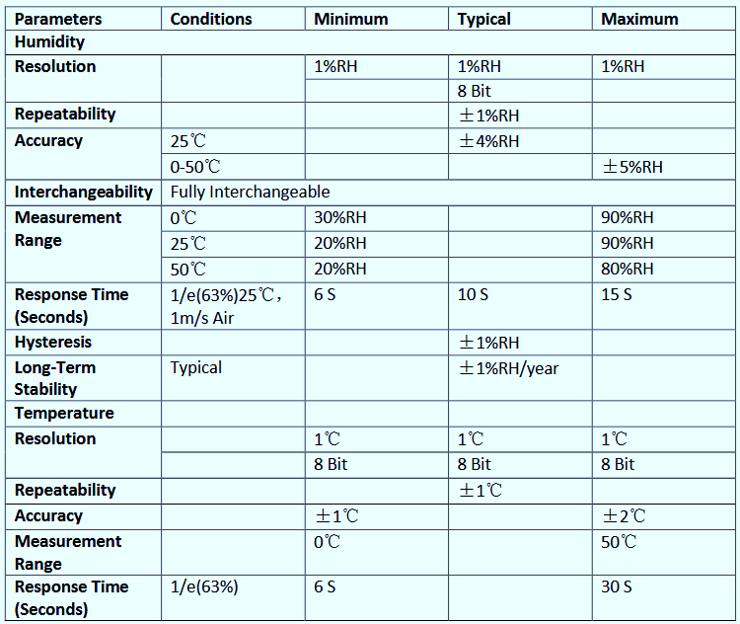
TECHNICAL SPECIFICATIONS(detailed):

Slide 9
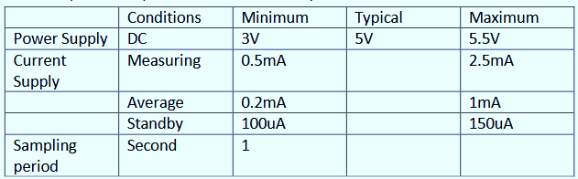
ELECTRICAL CHARACTERISTICS:

Slide 10
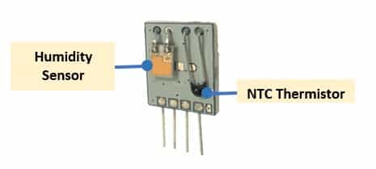
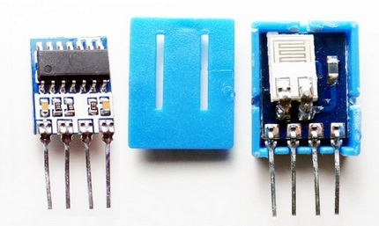
DHT11 WORKING:
The DHT11 sensor is made up of three major internal parts. These include the capacitive humidity sensor, NTC (Negative Temperature Coefficient) thermistor, and the 8-bit microcontroller. The capacitive humidity sensor detects the humidity in the environment through measuring capacitance. The NTC thermistor detects the temperature in the environment through measuring the change in resistance with respect to temperature. The 8-bit microcontroller processes the signals from the two sensors and translates them into digital data on humidity and temperature. It then packages the data into a 40-bit data frame that includes 16 bits for humidity, 16 bits for temperature, and 8 bits for the checksum.[2]

Slide 11
DHT11 Temperature Measurement:
For temperature sensing, it has an NTC(Negative Temperature Coefficient) temperature sensor (also called a thermistor ) mounted on the surface inside the plastic casing.
NTC temperature sensors are variable resistive sensors and their resistance decreases with an increase in the surrounding temperature.
Thermistors are designed with the sintering of semiconductor materials, such as ceramic or polymers and they provide a large change in resistor with a small temperature change.
Here's the graph showing the relation between temperature and resistance for the DHT11 sensor:

Slide 12
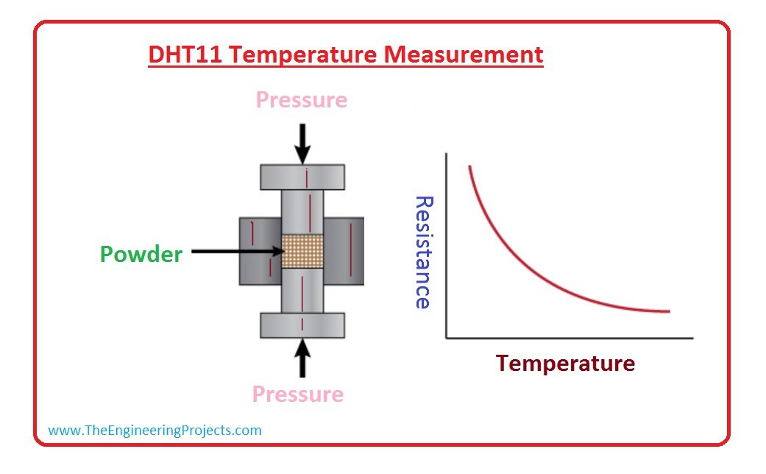

Slide 13
DHT11 Humidity Measurement:
For Humidity Measurement, it uses a capacitive humidity sensor, which has two electrodes and a substrate material in between.
The substrate material is used for holding the moisture on its surface.
As moisture content changes in our environment, they get saturated on the substrate material, which in turn changes the resistance between electrodes.
This change in electrode resistivity is then calibrated using the humidity coefficient (saved in OTP memory) and the final relative humidity value is released.[2]
Here's the image showing the internal structure of the DHT11 humidity sensor:

Slide 14
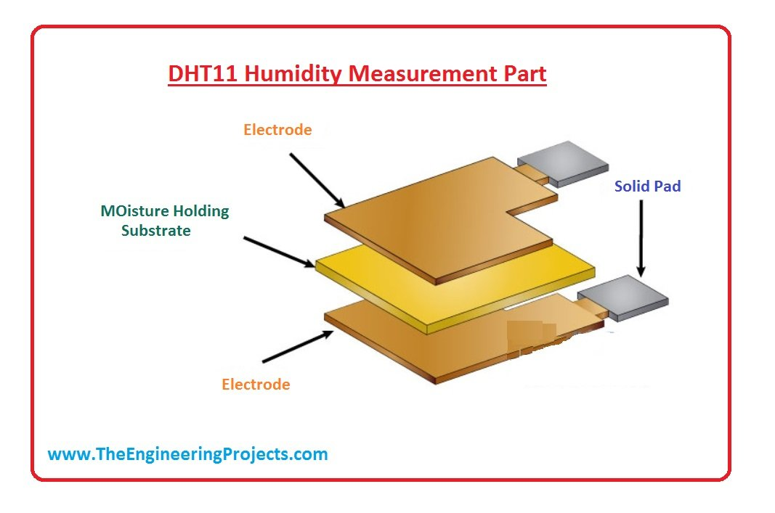

Slide 15
DHT11 Data Format:
The DHT11 uses a single-bus digital communication protocol to transmit temperature and relative humidity measurements to a microcontroller. The sensor sends a total of 40 bits, organized into five 8-bit bytes, with the most significant bit (MSB) transmitted first.[4]
Byte | Contents | Description
Byte 1 | Integral humidity | Whole-number relative humidity value (%)
Byte 2 | Decimal humidity | Decimal part; normally 0 for DHT11
Byte 3 | Integral temperature | Whole-number temperature value (°C)
Byte 4 | Decimal temperature | Decimal part; normally 0 for DHT11
Byte 5 | Checksum | Used to verify the received data (Byte 1 + Byte 2 + Byte 3 + Byte 4)

Slide 16
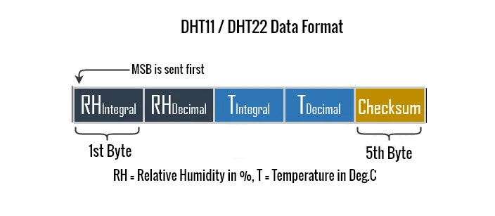
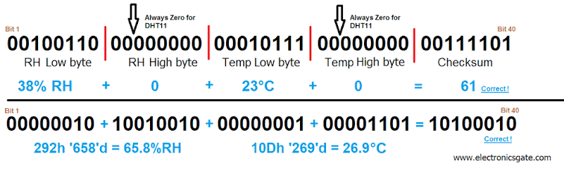
DHT11 Data Format:
Ref: http://electronicsgate.com/tutorials/dht22.html & https://iotbyhvm.ooo/dht11-vs-dht22-overview/

Slide 17
How does the checksum work?
The checksum is calculated by adding the first four bytes and retaining the lower 8 bits of the sum.
Checksum=(B1+B2+B3+B4)
  Example: Suppose the sensor transmits:
  Byte 1 = 55 (humidity: 55%)
  Byte 2 = 0
  Byte 3 = 28 (temperature: 28°C)
  Byte 4 = 0
  Byte 5 = 83 (checksum)
The receiver calculates (55+0+28+0=83) and compares the result with Byte 5. If they match, the data passes the checksum verification.[4]

Slide 18
Communication Process: Serial Interface (Single-Wire Two-Way)
Single-bus data format is used for communication and synchronization between MCU and DHT11 sensor. One communication process is about 4ms.
When MCU sends a start signal, DHT11 changes from the low-power-consumption mode to the running-mode, waiting for MCU completing the start signal. Once it is completed, DHT11 sends a response signal of 40-bit data that include the relative humidity and temperature information to MCU. Users can choose to collect (read) some data. Without the start signal from MCU, DHT11 will not give the response signal to MCU. Once data is collected, DHT11 will change to the low power-consumption mode until it receives a start signal from MCU again.[3]
Before sending each bit the DHT will pull tle line down for 50ms and then make it high based on which bit needs to be sent.

Slide 19
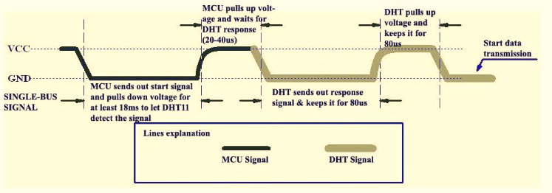
MCU Start Signal to DHT11:
MCU will set Data Single-bus voltage level from high to low and this process must take at least 18ms to ensure DHT’s detection of MCU's signal, then MCU will pull up voltage and wait 20-40us for DHT’s response.

Slide 20
DHT Responses to MCU:
Once DHT detects the start signal, it will send out a low-voltage-level response signal, which lasts 80us. Then the programme of DHT sets Data Single-bus voltage level from low to high and keeps it for 80us for DHT’s preparation for sending data[3]
When DATA Single-Bus is at the low voltage level, this means that DHT is sending the response signal. Once DHT sent out the response signal, it pulls up voltage and keeps it for 80us and prepares for data transmission.
When DHT is sending data to MCU, every bit of data begins with the 50us low-voltage-level and the length of the following high-voltage-level signal determines whether data bit is "0" or "1“.[3]
If the response signal from DHT is always at high-voltage-level, it suggests that DHT is not responding properly and please check the connection. When the last bit data is transmitted, DHT11 pulls down the voltage level and keeps it for 50us. Then the Single-Bus voltage will be pulled up by the resistor to set it back to the free status.[3]

Slide 21
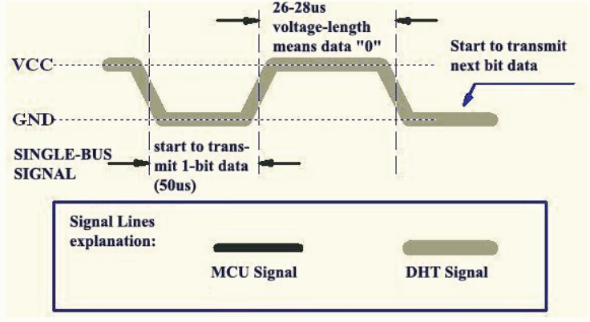
DATA ‘0’ INDICATION:
The bit ‘0’ is detected by the MCU if the DHT sends low signal for 50us and high for 26-28ms as shown in the below figure.[3]

Slide 22
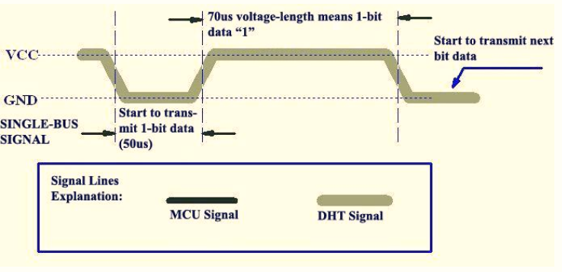
DATA ‘1’ INDICATION:
The bit ‘1’ is detected by the MCU if the DHT sends low signal for 50us and high for 70us as shown in the below figure.[3]

Slide 23
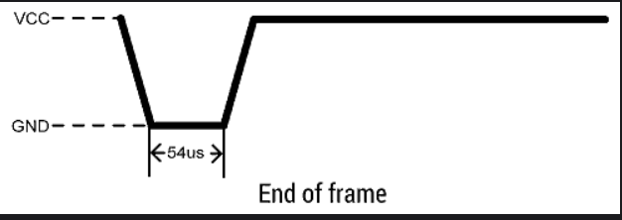
End of the frame:
Once the DHT11 sensor has transmitted the data (temperature and humidity values), it enters a low-power consumption mode. During this time, the sensor is idle and does not transmit any further data until the next start pulse is sent by the microcontroller.[3]
50us

Slide 24
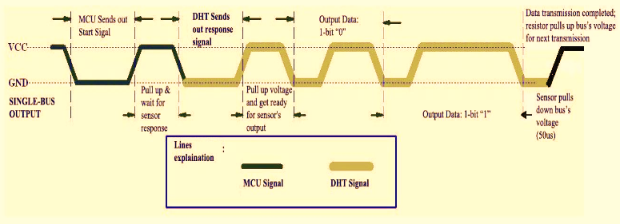
Overall Communication Process:

Slide 25
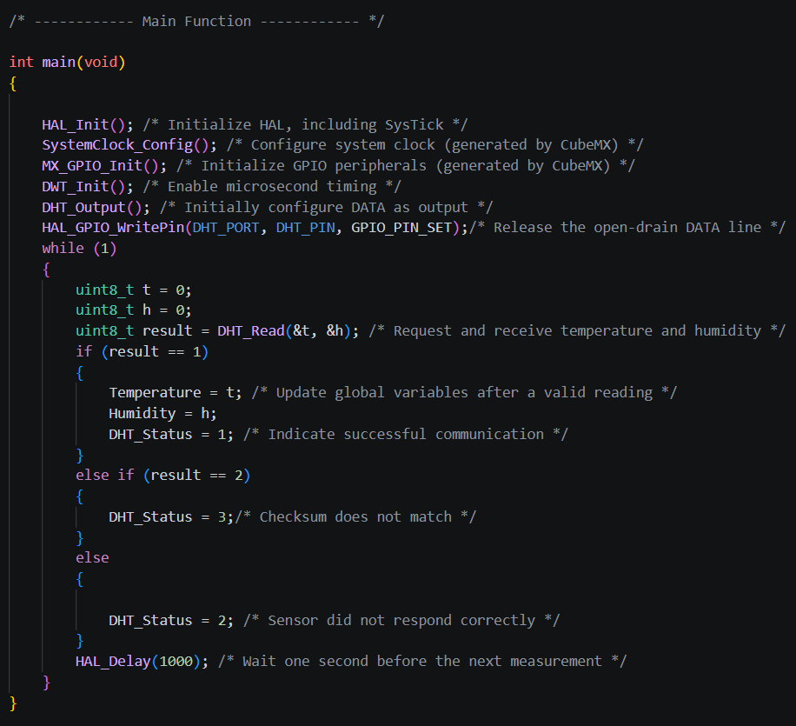
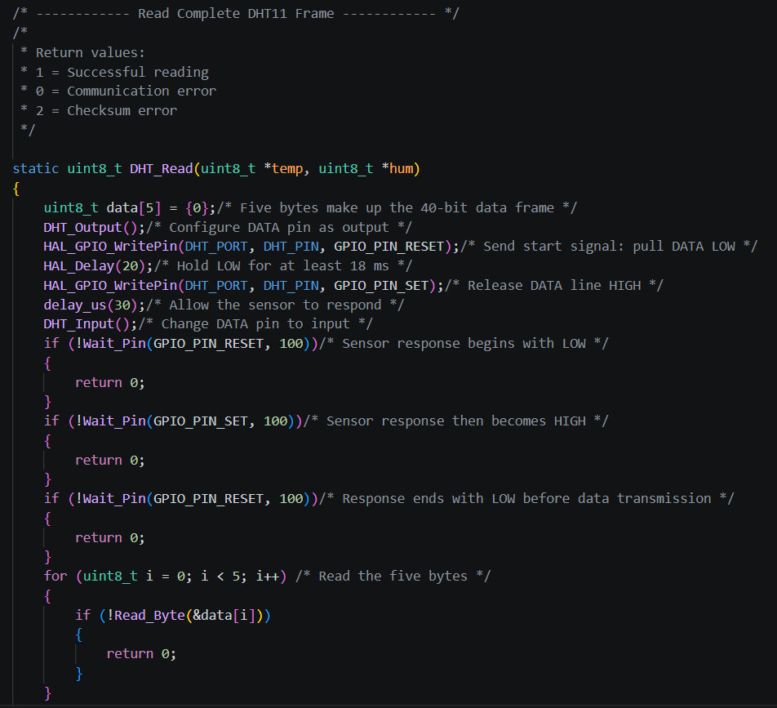
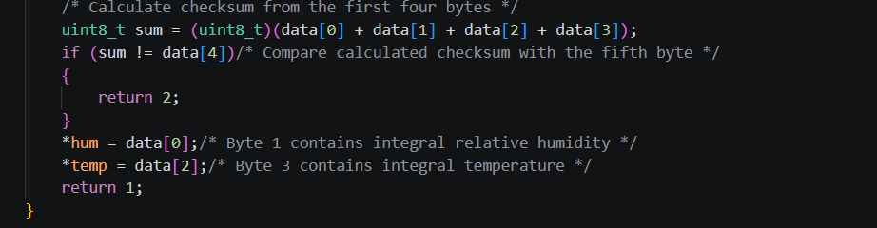
Interfacing DHT11 with STM32:

Slide 26
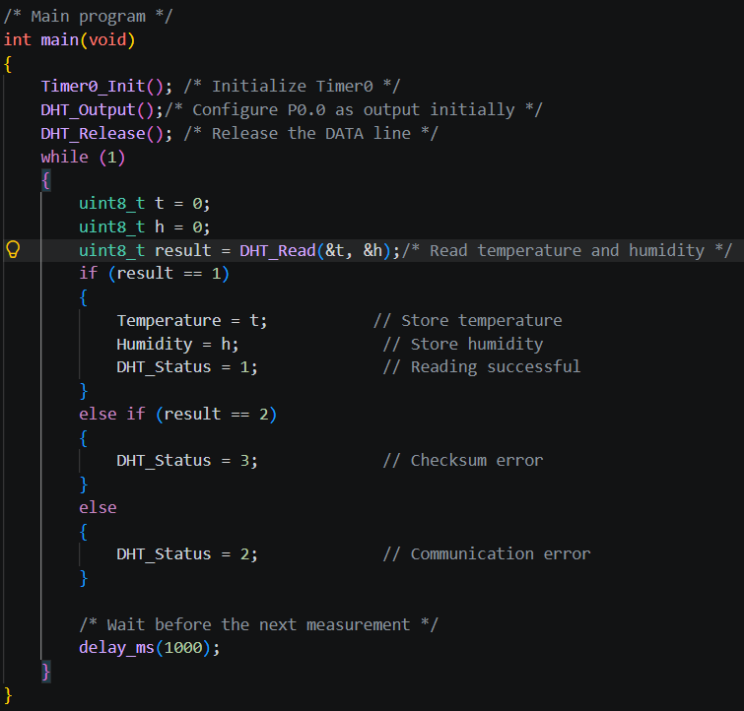
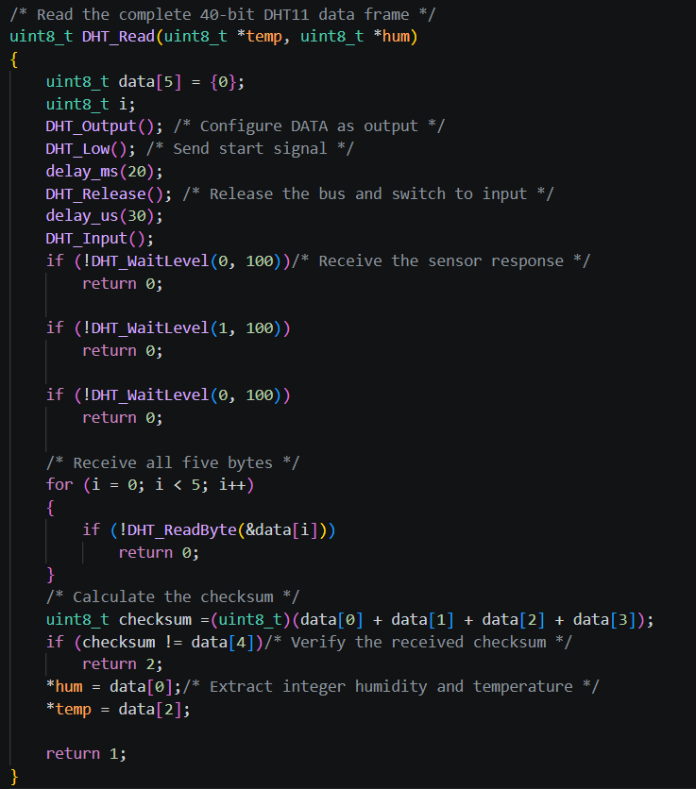
Interfacing DHT11 with LPC1768:

Slide 27
References:
[1] Aosong (Guangzhou) Electronics Co., Ltd., “DHT11 Product Manual: Temperature and Humidity Module.”
[2] zahidali, “Introduction to DHT11,” The Engineering Projects.
[3] “DHT11 Humidity & Temperature Sensor”.
[4] “DHT11 vs DHT22 | Difference between DHT11 and DHT22.” Available: https://iotbyhvm.ooo/dht11-vs-dht22-overview/
[5] https://github.com/AbdulRehaman7/dht11-interfacing

Slide 28
THANK YOU

